Slide 1
Initial
Design Review
Zeus Development Group
April 10th, 2026
Christina Walker, Diego Cummins, Jessy Pena, Jose Aguirre, Noah Schatz

Slide 2
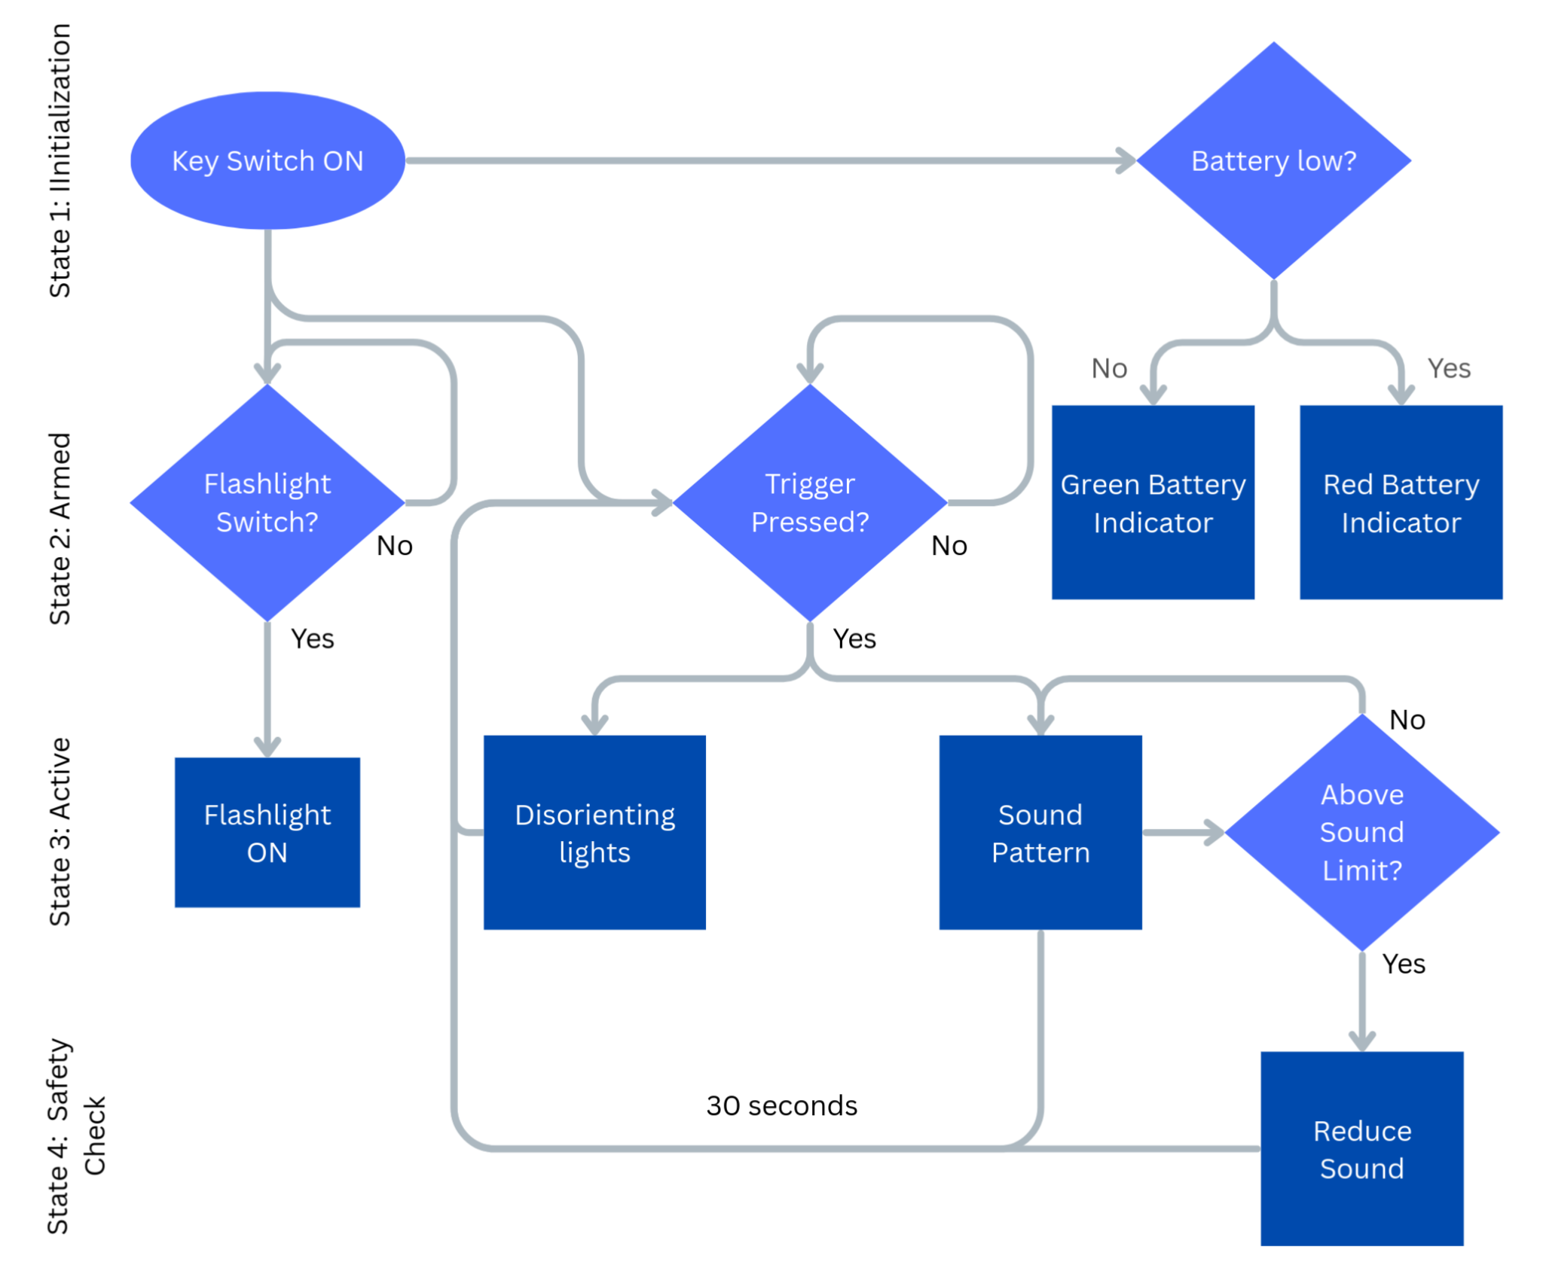
Data Acquisition
Zeus Development Group
Christina Walker
Christina Walker
Primary Responsibility: Developing data acquisition and logging system
Role in the project:
  Data logging system for speaker, microphone, and LEDs
  Monitoring of sound and light outputs
  System safety, testing, and validation
Contributions I’ve made
  Data acquisition for microphone input
  Real-time sound level logging system
  Tested speaker and LEDS

Slide 3
Here’s what I did:
Zeus Development Group
Christina Walker
 | COMPLETED | IN PROGRESS | NOT STARTED
Data logging system for speaker, microphone, and LED outputs
Integrate sensor data with microcontroller
Basic data storage/logging functionality
Support system testing and validation
-
50%
-
-
45%
-
-
-
-
30%
-

Slide 4
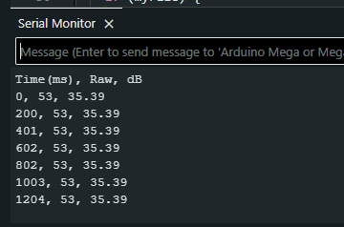
Issues I had:
Zeus Development Group
Christina Walker
1. Problems
2. Solutions
3. Projected Impact
Design changes
Uncertainty in final system parameters
Limited progress on implementation
Need to ensure compatibility between multiple subsystems
Design a flexible logging system that can adapt to changing inputs
Use placeholder values for testing until specifications are finalized
Minor delays expected due to changes in requirements
Estimated completion of data logging implementation: within 1 week
Estimated completion of integration and testing: within 2–3 weeks

Slide 5
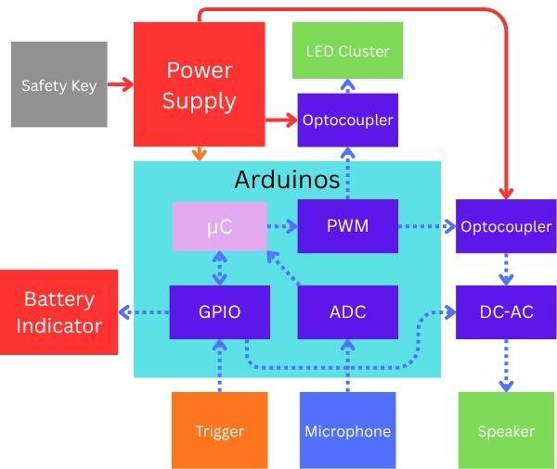
Power Systems Engineer
Zeus Development Group
Diego Cummins
Diego Cummins
Project Role
  Design and analyze the power architecture for Zeus.
  Design power converters for the LED and speaker subsystems
  Define power requirements, peak and average power budgets, and duty-cycle limitations to ensure safe
Summary of my contributions
  Created a model of the housing for the lights.
  Done simple calculations for the power requirements of the lights.
  Creating model of exterior of the device.

Slide 6
Here’s what I did:
Zeus Development Group
Diego Cummins
COMPLETED
IN-PROGRESS
NOT STARTED
Calculated power requirement for LEDs
100%
-
LED housing model
100%
-
Model of exterior of
device
-
30%
-
Design of power converters
-
-
Create DC to AC Converter Circuit for speaker
-
-

Slide 7
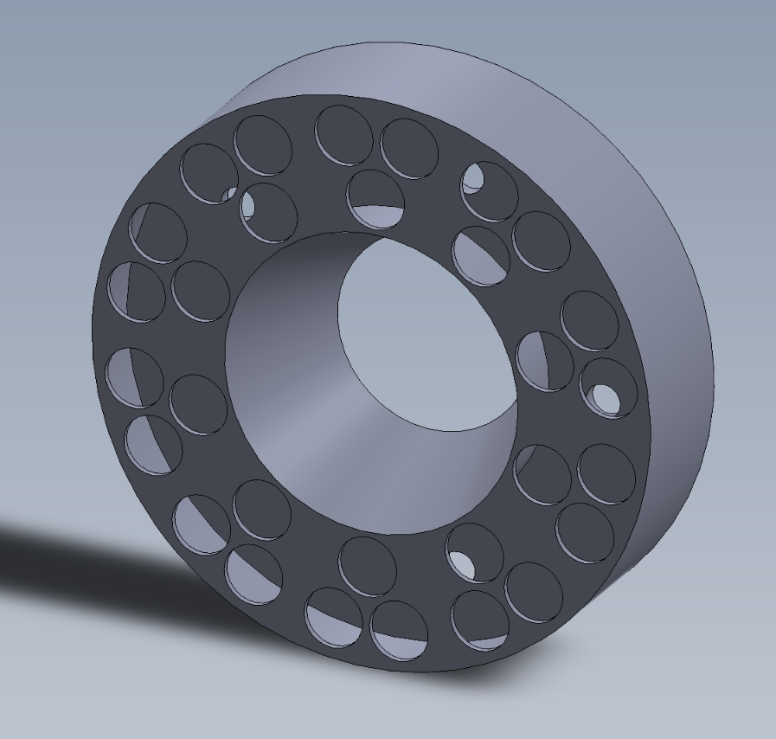
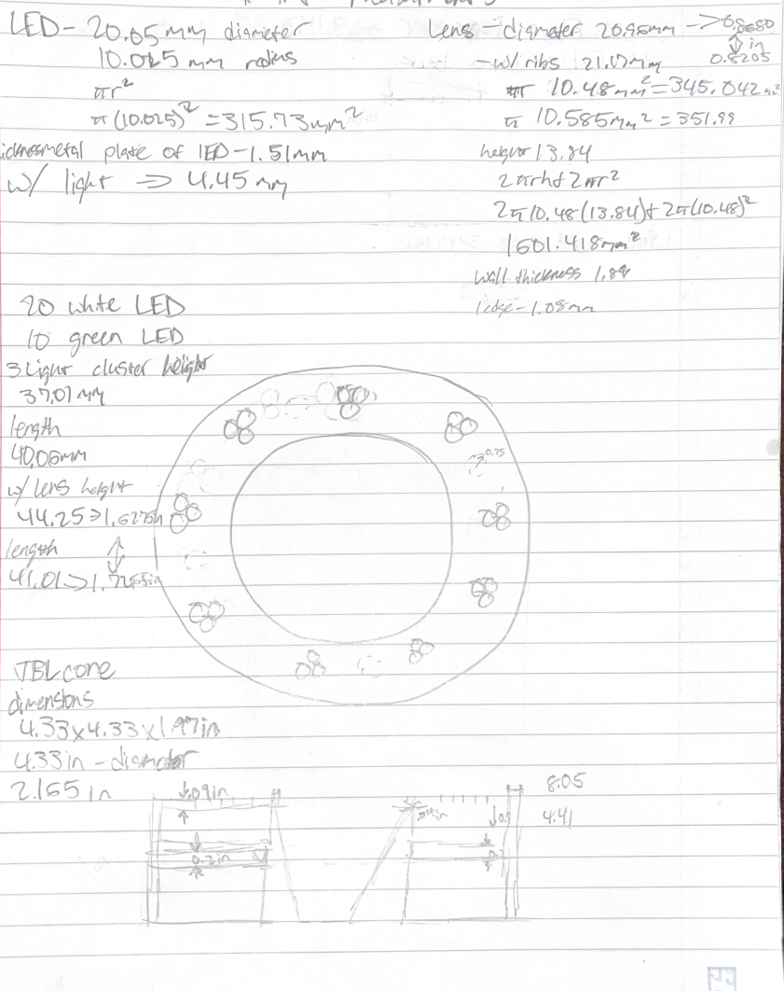
Issues I had:
Zeus Development Group
Diego Cummins
1. Problems
2. Solutions
3. Projected Impact
Minimal space to work with while modeling the LED housing.
Sudden changes in design
Parts not meeting what they advertised to output.
Understanding of power converters
Pivot into using less LEDs
Redesign of entire device caused changes in measurements.
Overcompensation of power requirements in order to handle added strain if needed.
Researched converters and have done simulations in other power focused classes.
Improper heat sinking
Increase in modeling time investment
Delay in converter design as well as errors in calculations and efficiency.

Slide 8
Hardware Integration Engineer
Zeus Development Group
Jessy Pena
Jessy Pena
My role is to:
  Verify compatibility of various components
  Design interior framework of device
  Compile circuit into comprehensive PCB
A summary of my contributions:
  Soldered & tested LEDs’ working and max loads
  Built circuit on breadboard to verify correct power distribution
  Creating CAD model of interior components

Slide 9
Here’s what I did:
Zeus Development Group
Jessy Pena
NOT STARTED
 | COMPLETED | IN PROGRESS | NOT STARTED
Soldered & Tested LEDs Max & Working Loads |  | 100%
Verify compatibility of components | - | 50%
Create CAD Model of interior | - | 20%
Compile circuit into comprehensive PCB | - | 0%
-
-
-

Slide 10
Issues I had:
Zeus Development Group
Jessy Pena
1. Problems
2. Solutions
3. Projected Impact
Indecision on what components would be best to use for the device
Cross-platform incompatibility between Solidworks & Fusion360
Clear communications of updates on findings with safety requirements research
Need to learn SolidWorks in order to properly integrate interior with OR keep files separate
Delay created ordering components, therefore testing may be delayed by potentially weeks
Delay with learning software OR potential incompatibility issues when printing parts

Slide 11
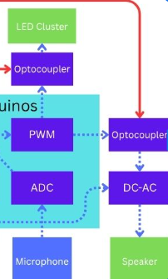
Embedded Systems Engineer
Zeus Development Group
Jose Aguirre
Jose Aguirre
Designed circuits to be implemented in the device.
  Researched on LED’s with the needed lumen.
  Designed LED circuit to implement into the microcontroller.
  Tested LED’s actual limits in order to have more accurate data.
This is a summary of the biggest contributions I’ve made.
  Designed the Draft LED circuit.
  Tested LED’s limit.

Slide 12
Here’s what I did:
Zeus Development Group
Jose Aguirre
COMPLETED
IN-PROGRESS
NOT STARTED
LED Circuit Design
-
-
LED Circuit Simulation
-
90%
-
Speaker Circuit Design
-
-
-
Speaker Circuit Simulation
-
-
-
LED and Speaker Circuit Design
-
-
-

Slide 13
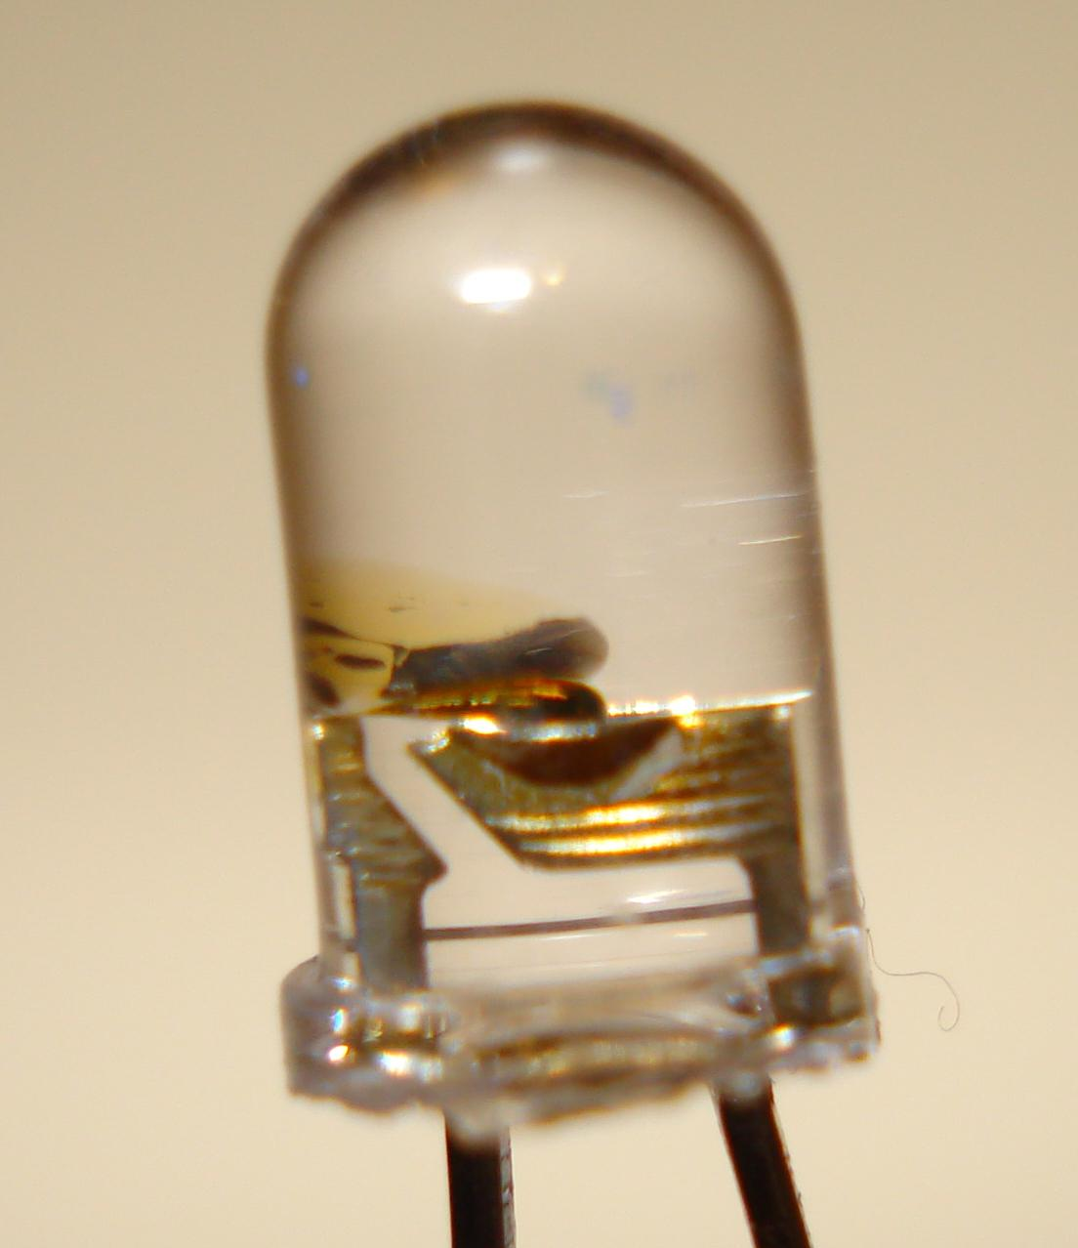
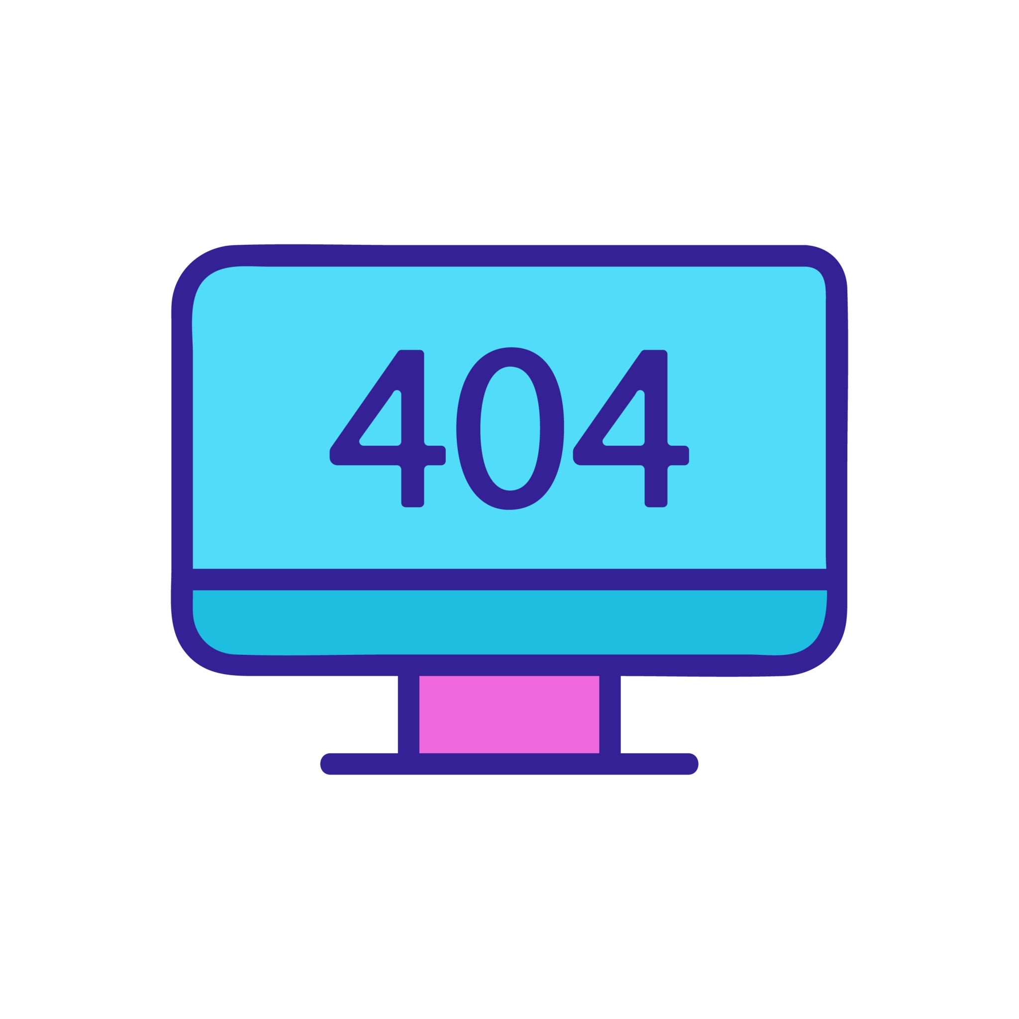
Issues I had:
Zeus Development Group
Jose Aguirre
1. Problems
2. Solutions
3. Projected Impact
Complex LED’s are needed for the desired intensity.
Circuit Design programs complexity needed to simulate specific components properly.
Use resistors for each LED in order to control every individual LED thru the microcontroller.
Learn PSpice to a more complex level than what I have used, or change programs.
Can’t properly test LED circuit before implementation without damaging the components.

Slide 14
Control Systems and UI Engineer
Zeus Development Group
Noah Schatz
Noah Schatz
Designed algorithms to regulate the sound and light patterns
  Researched light strobe frequency
  Experimented with different low freq patterns
  Tested various sound wave shapes and frequencies
This is a summary of the biggest contributions I’ve made.
  Determined ideal sound frequencies
  Determined most disorienting light flicker and strobe

Slide 15
Here’s what I did:
Zeus Development Group
Noah Schatz
COMPLETED
IN-PROGRESS
NOT STARTED
Determined most effective light flickering frequency
-
-
Programmed various “random” strobe patterns to cycle through
-
90% *
-
Programmed green light cycle.
-
-
Determined ideal sound frequencies
-
-
Programming the sound
-
-
* Needs further testing with a completed prototype

Slide 16
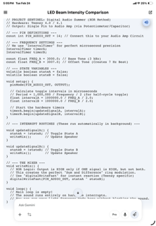
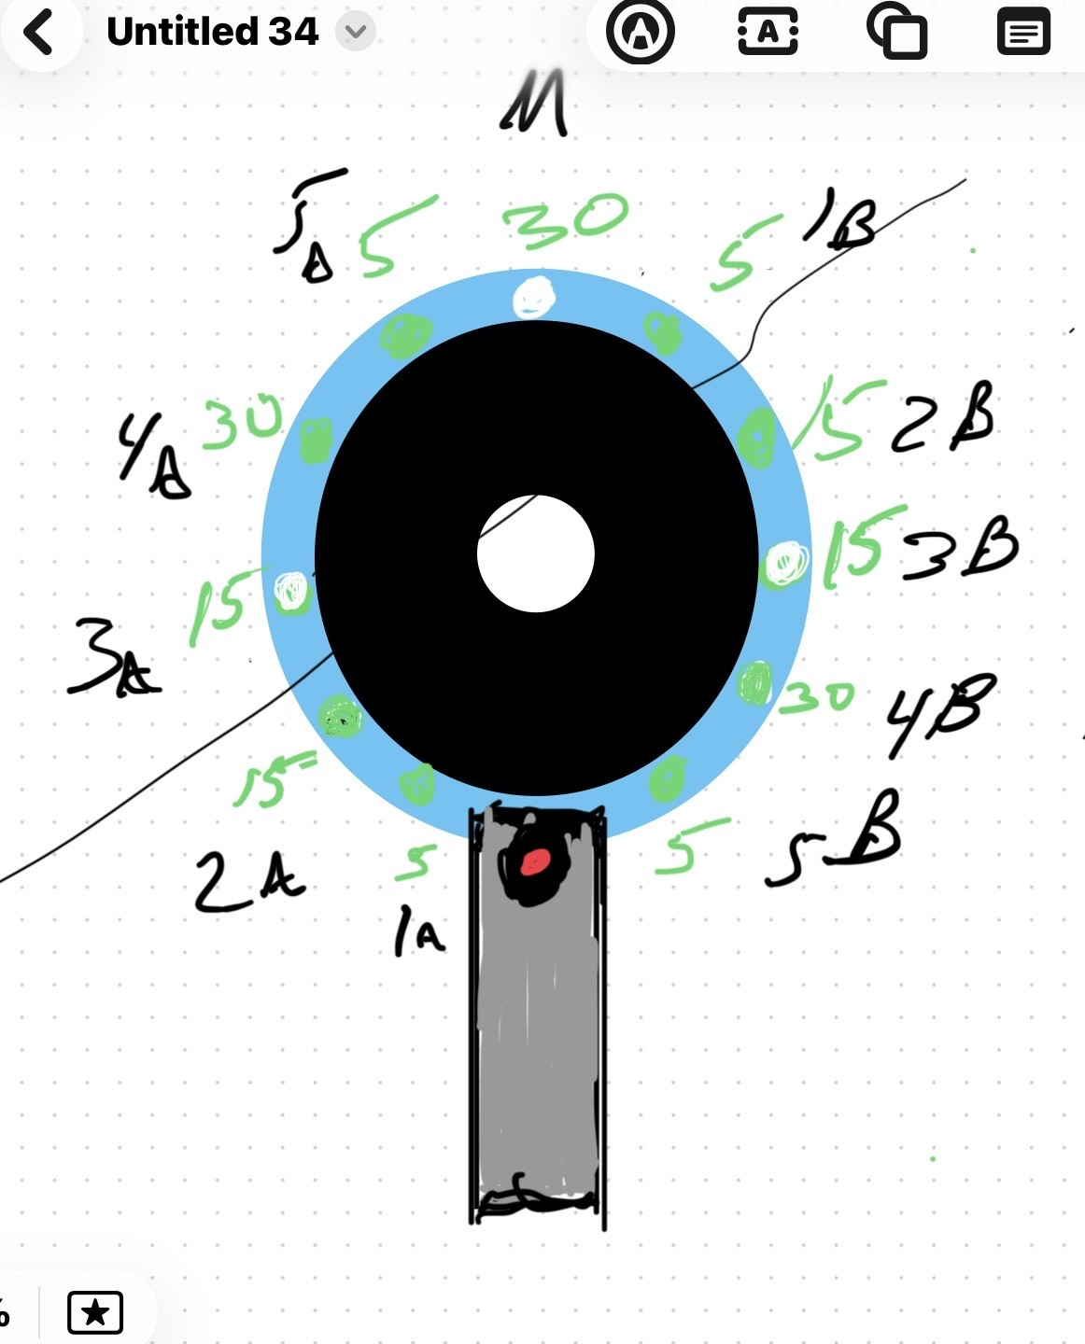
Issues I had:
Zeus Development Group
Noah Schatz
1. Problems
2. Solutions
3. Projected Impact
No major technical errors
Changing requirements for the LED and sound algorithms
  Different number of lights
  Different light functions and patterns
Discussed what areas needed to be backed by our own development (for the sake of the course)
Set a framework of communication in terms of how adjustments and alterations would be made
Software development should progress fairly quickly now that the number of changes has stabilized.
The majority of the work will be in testing and refinement
  The remaining code shouldn’t be difficult to draft

Slide 17
Thank you!
Zeus Development Group
April 10th, 2026
Any questions?
Contact
zeusdevgroup@gmail.com

